Slide 1
PYTHON
DAY 1

Slide 2

What is Software?

Slide 3
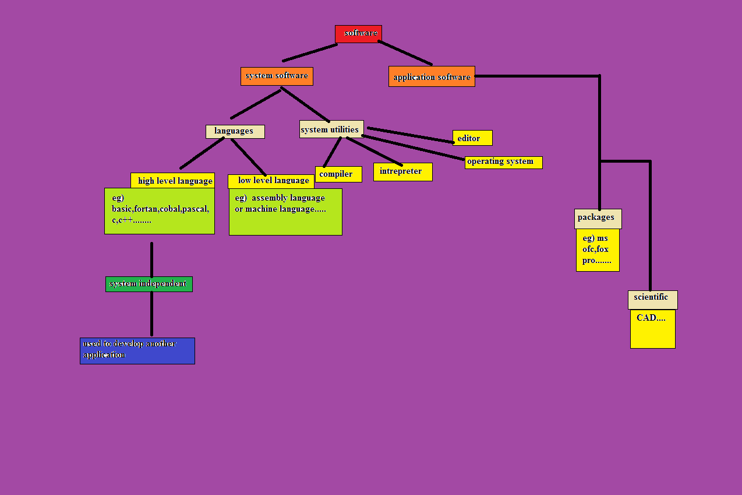

Slide 4
Introduction to Python
Developed by Guido Van Rossum during 1985-1990.
Python is a general-purpose interpreted, interactive, object-oriented, scripting and high level programming language.

Slide 5
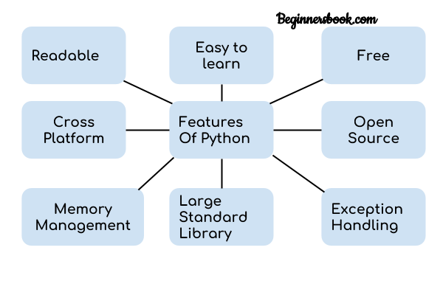
Features of Python

Slide 6
What Can You Do with Python?
Web development.
Machine learning.
Data Analysis.
Scripting.
Game development.
Desktop applications.
You can develop Embedded Applications in Python.

Slide 7
Advantages
Presence of third-party modules.
Extensive support libraries.
Easy to learn.
User friendly data structures.
Productivity and Speed.
High level language.
Dynamically typed language.
Object oriented language.
Portable and Interactive.
Portable across OS.

Slide 8
Organizations using Python
Google
Yahoo
You Tube
Mozilla
Drop box
Microsoft
NASA

Slide 9
SOURCE PROGRAM
INPUT
Interpreter
OUTPUT

Slide 10
COMPILER vs INTERPRETER
COMPILER
INTERPRETER
Takes an entire program as an input.
Generates intermediate object code.
Executes faster.
Requires more memory in order to create object code.
Doesn’t need to compile every single time, just once.
C, C++... Use compiler.
Takes an single line of code, or instruction, as its input.
Does not generates any intermediate object code.
Executes slower
Requires less memory(does not create object code)
Has to convert high-level languages to low-level programs at execution.
Python, Ruby use interpreters.

Slide 11
Starting the Interpreter
Interactive mode
Script mode
Command line mode

Slide 12
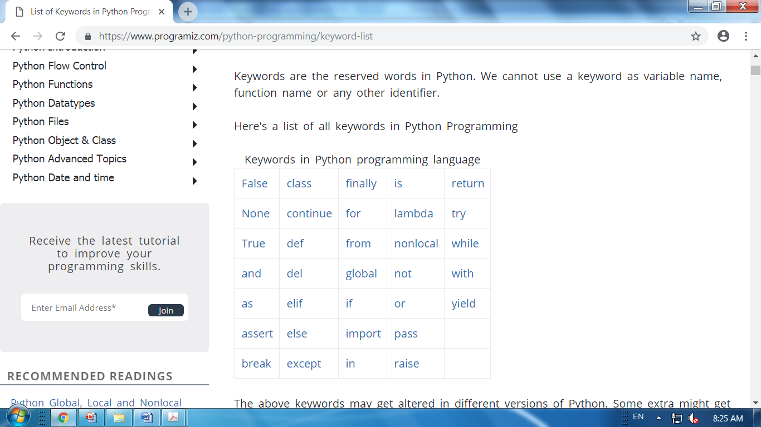

Slide 13
Memory Management
Variable not declared ahead of time.
Variables types are not declared.
No memory management or programmers’ part.
Variable names can be “recycled”.
Del statement allows for explicit “de allocation”.

Slide 14
Python Style Variable
In Python Every value as a unique id and it treats like a object PyObject.
Every python object holds three things
Its type
Its value
Its Reference count

Slide 15
>>> a=10
>>> a
10
>>> id(a)
3341964
>>> type(a)
<type ‘int’>
>>>

Slide 16
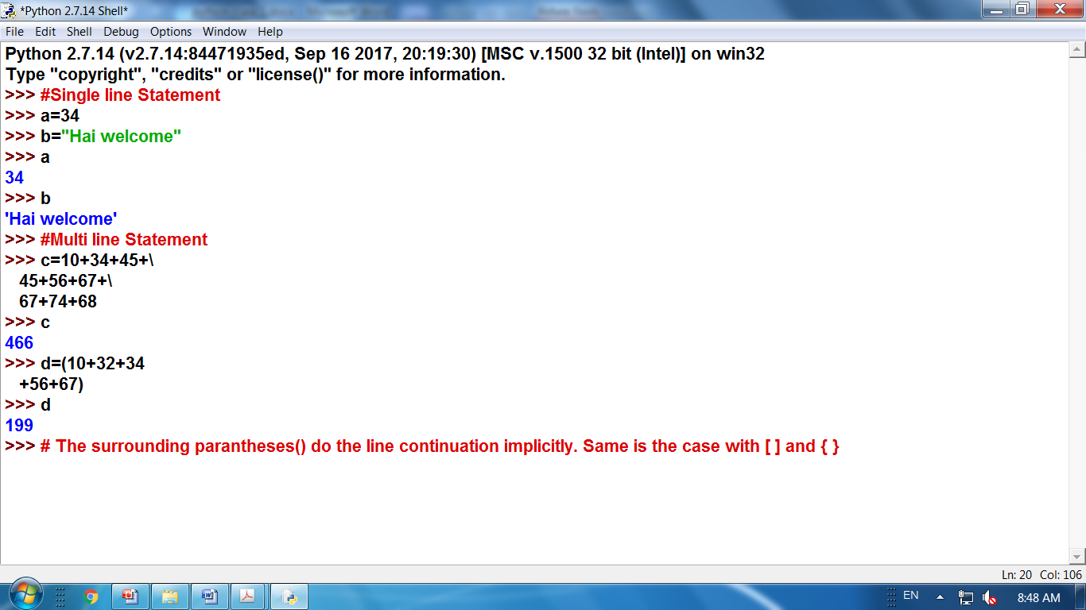

Slide 17
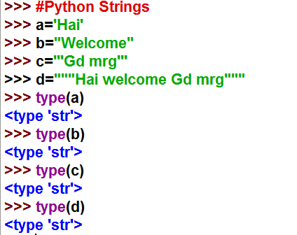

Slide 18
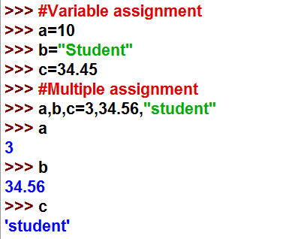

Slide 19
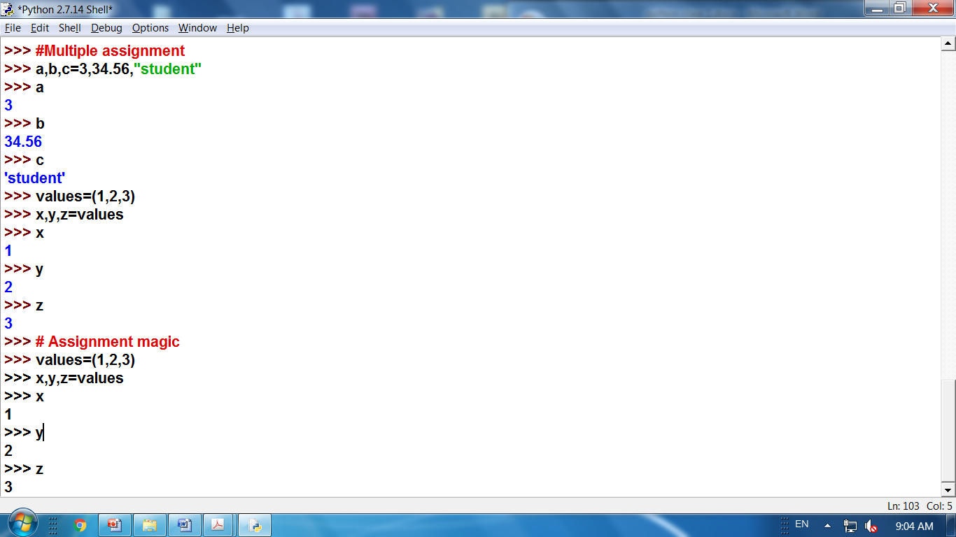

Slide 20
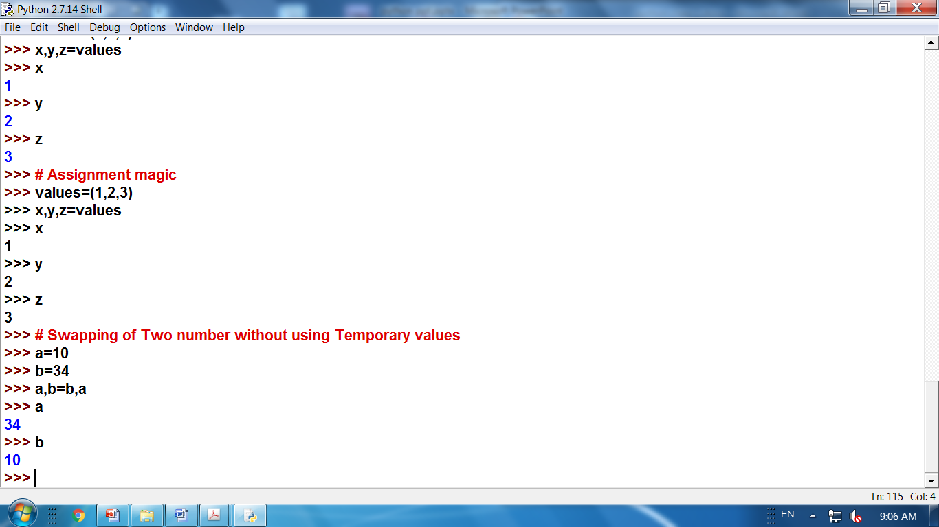

Slide 21
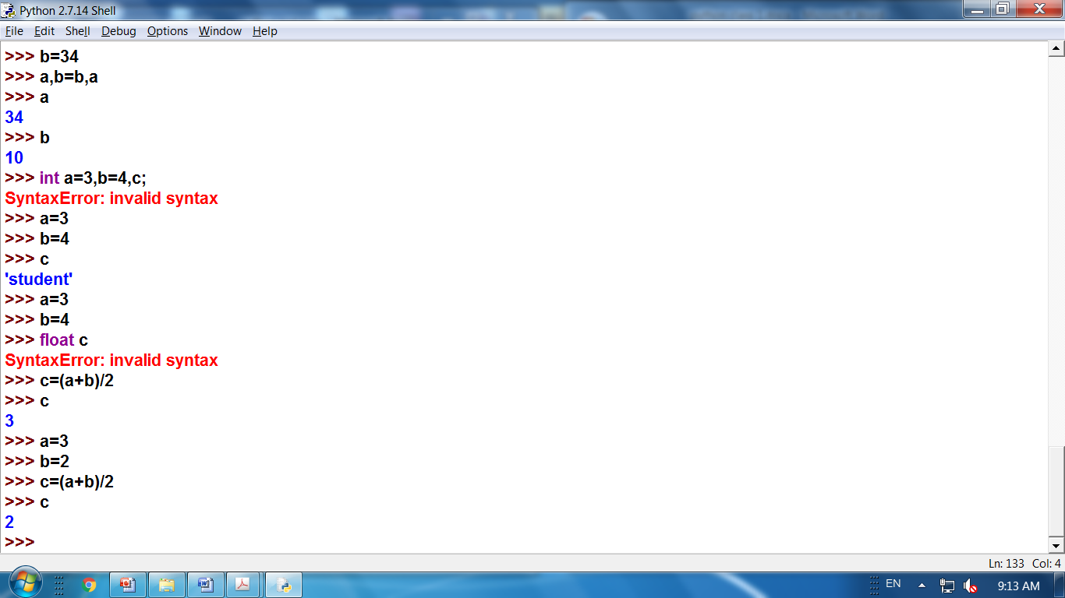
Automatic Type casting like based on result
In C language
int a=3,b=3,c;
float c;
c=(float)(a+b)/2
Then only we get the value c=3.4 other wise 3.0
But in python
No Declaration and No Type Casting

Slide 22
Data types in python
Every value in Python has a data type. Since everything is an object in Python programming, data types are actually classes and variables are instance(object) of these classes.

Slide 23
Python Numbers
Integer
Long Integer
Float
Complex

Slide 24
Python Input, Output
print(1,2,3,4)
print(1,2,3,4,sep=‘*’)
print(1,2,3,4,sep=‘#’,end=‘!’)
Output:
1 2 3 4
1*2*3*4
1#2#3#4!

Slide 25
String Data Type
String are identified as a contiguous set of characters represented in the quotation marks. Python allows for either
pairs of single or double quotes. Strings are immutable sequence data type, i.e each time one makes any changes
to a string, completely new string object is created.

Slide 26
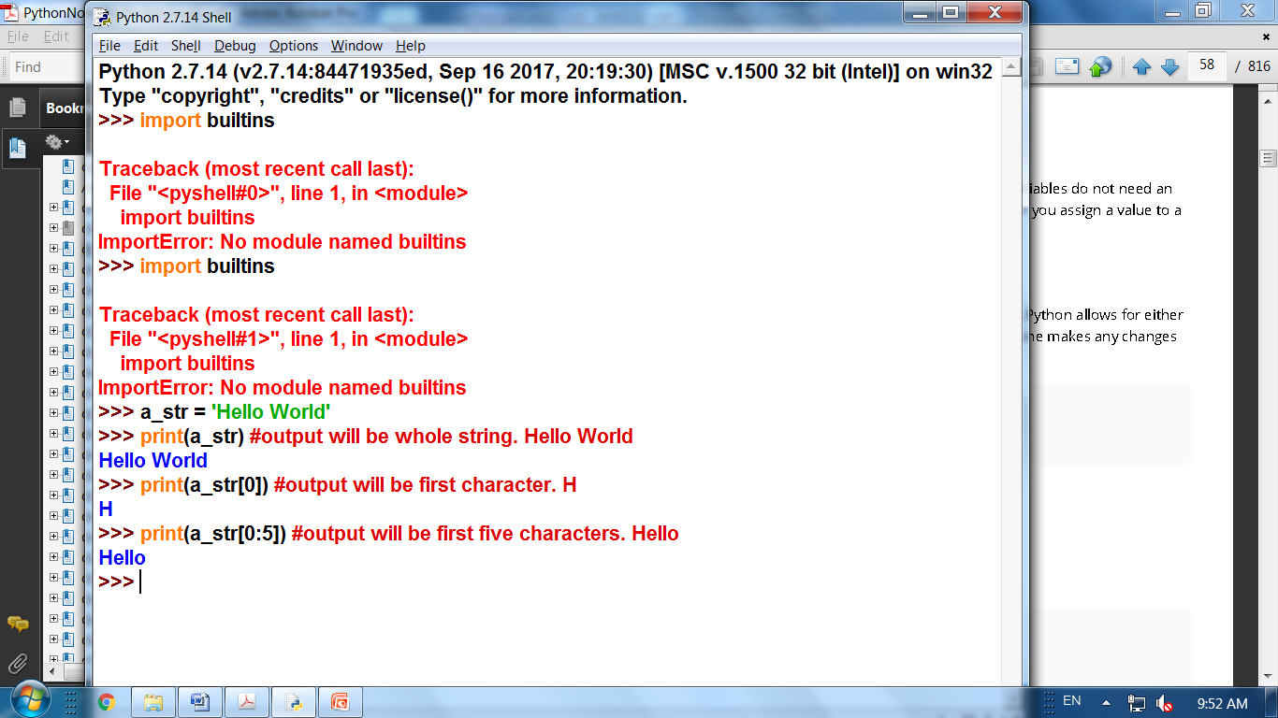

Slide 27
Set Data Types
Sets are unordered collections of unique objects, there are two types of set:
1. Sets - They are mutable and new elements can be added once sets are defined
2. Frozen Sets - They are immutable and new elements cannot added after its defined.

Slide 28
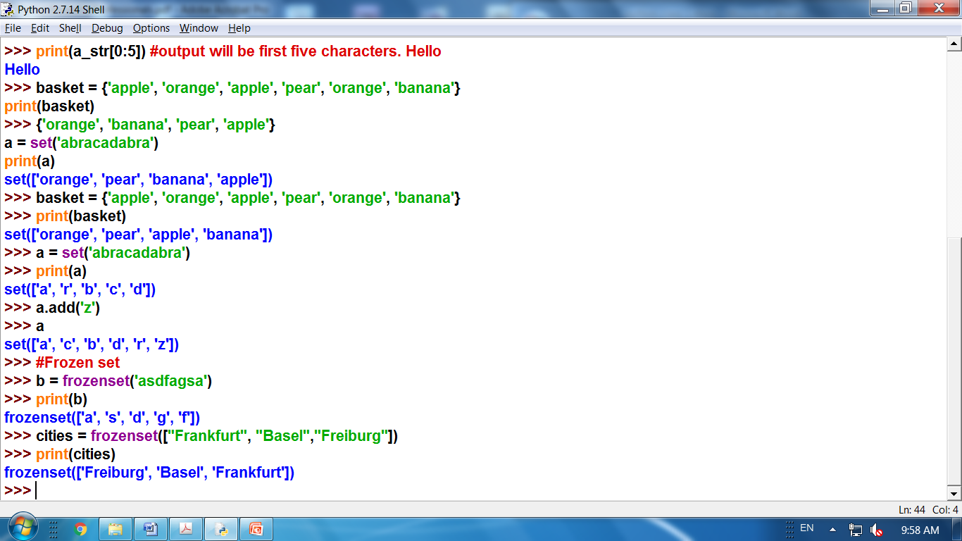

Slide 29
List Data Type
A list contains items separated by commas and enclosed within square brackets [].lists are almost similar to arrays
in C. One difference is that all the items belonging to a list can be of different data type.

Slide 30
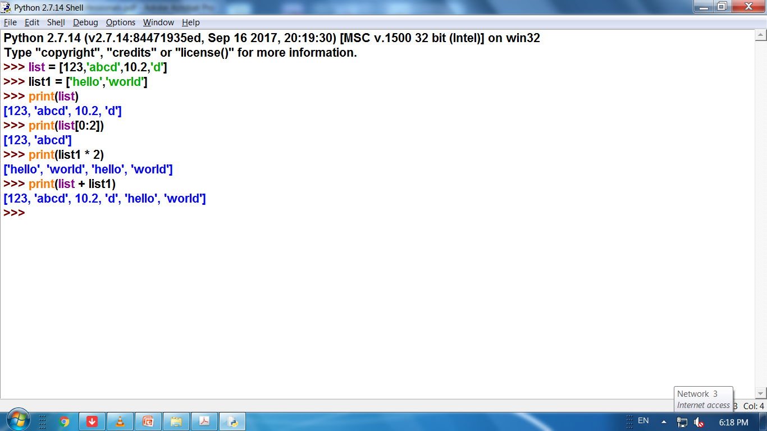

Slide 31
Dictionary Data Type
Dictionary consists of key-value pairs. It is enclosed by curly braces {} and values can be assigned and accessed
using square brackets[].

Slide 32
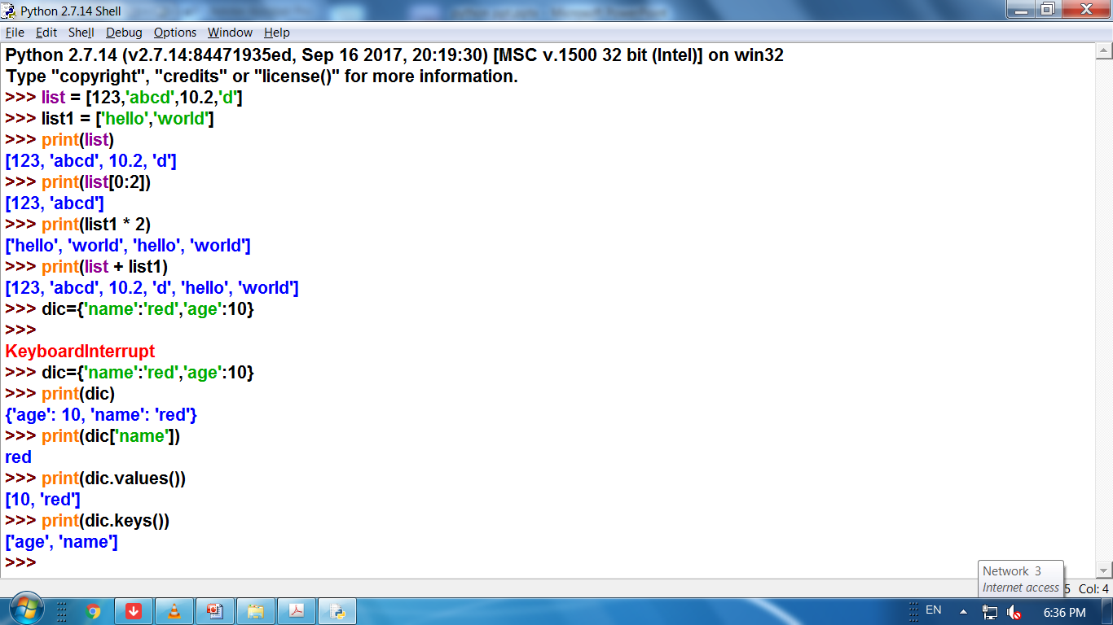

Slide 33
Tuple Data Type
Lists are enclosed in brackets [ ] and their elements and size can be changed, while tuples are enclosed in
parentheses ( ) and cannot be updated. Tuples are immutable.

Slide 34
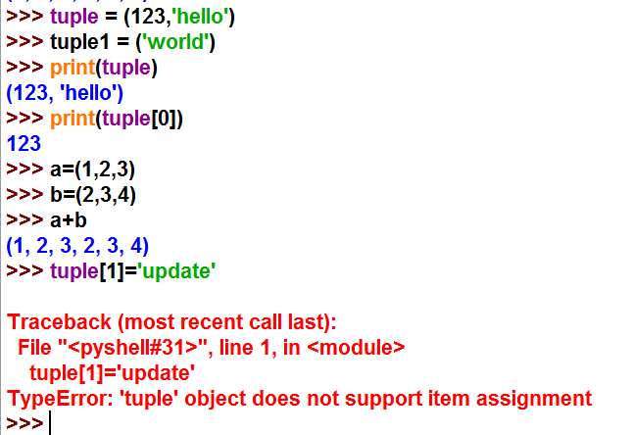

Slide 35
Python Import
Python import
When our program grows bigger, it is a good idea to break it into different modules.
A module is a file containing Python definitions and statements. Python modules have a filename and end with the extension .py.
Definitions inside a module can be imported to another module or the interactive interpreter in python. We use the import keyword to do this.
For example, we can import the math module by typing in import math.
Import math

Slide 36
Operators
Arithmetic operators
Logical operators
Relational operators
Bitwise operators
Assignment operators
Special operators
Membership operators

Slide 37
Arithmetic operators
OPERATOR | DESCRIPTION | SYNTAX
+ | Addition: adds two operands | x + y
- | Subtraction: subtracts two operands | x - y
* | Multiplication: multiplies two operands | x * y
/ | Division (float): divides the first operand by the second | x / y
// | Division (floor): divides the first operand by the second | x // y
% | Modulus: returns the remainder when first operand is divided by the second | x % y

Slide 38
# Examples of Arithmetic Operator
a = 9
b = 4
# Addition of numbers
add = a + b
# Subtraction of numbers
sub = a - b
# Multiplication of number
mul = a * b
# Division(float) of number
div1 = a / b
# Division(floor) of number
div2 = a // b
# Modulo of both number
mod = a % b
# print results
print(add)
print(sub)
print(mul)
print(div1)
print(div2)
print(mod)
Output:
13 5 36 2.25 2 1

Slide 39
Relational Operators
OPERATOR | DESCRIPTION | SYNTAX
> | Greater than: True if left operand is greater than the right | x > y
< | Less than: True if left operand is less than the right | x < y
== | Equal to: True if both operands are equal | x == y
!= | Not equal to - True if operands are not equal | x != y
>= | Greater than or equal to: True if left operand is greater than or equal to the right | x >= y
<= | Less than or equal to: True if left operand is less than or equal to the right | x <= y

Slide 40
# Examples of Relational Operators
a = 13
b = 33
# a > b is False
print(a > b)
# a < b is True
print(a < b)
# a == b is False
print(a == b)
# a != b is True
print(a != b)
# a >= b is False
print(a >= b)
# a <= b is True
print(a <= b)
Output:
False True False True False True

Slide 41
Logical operators
OPERATOR | DESCRIPTION | SYNTAX
and | Logical AND: True if both the operands are true | x and y
or | Logical OR: True if either of the operands is true | x or y
not | Logical NOT: True if operand is false | not x
# Examples of Logical Operator
a = True
b = False
# Print a and b is False
print(a and b)
# Print a or b is True
print(a or b)
# Print not a is False
print(not a)

Slide 42
Bitwise operators
OPERATOR | DESCRIPTION | SYNTAX
& | Bitwise AND | x & y
| | Bitwise OR | x | y
~ | Bitwise NOT | ~x
^ | Bitwise XOR | x ^ y
>> | Bitwise right shift | x>>
<< | Bitwise left shift | x<<

Slide 43
# Examples of Bitwise operators
a = 10
b = 4
# Print bitwise AND operation
print(a & b)
# Print bitwise OR operation
print(a | b)
# Print bitwise NOT operation
print(~a)
# print bitwise XOR operation
print(a ^ b)
# print bitwise right shift operation
print(a >> 2)
# print bitwise left shift operation
print(a << 2)

Slide 44
Assignment operators
OPERATOR | DESCRIPTION | SYNTAX
= | Assign value of right side of expression to left side operand | x = y + z
+= | Add AND: Add right side operand with left side operand and then assign to left operand | a+=b a=a+b
-= | Subtract AND: Subtract right operand from left operand and then assign to left operand | a-=b a=a-b
*= | Multiply AND: Multiply right operand with left operand and then assign to left operand | a*=b a=a*b

Slide 45
Assignment operators
/= | Divide AND: Divide left operand with right operand and then assign to left operand | a/=b a=a/b
%= | Modulus AND: Takes modulus using left and right operands and assign result to left operand | a%=b a=a%b
&= | Performs Bitwise AND on operands and assign value to left operand | a&=b a=a&b
|= | Performs Bitwise OR on operands and assign value to left operand | a|=b a=a|b

Slide 46
Assignment operators
^= | Performs Bitwise xOR on operands and assign value to left operand | a^=b a=a^b
>>= | Performs Bitwise right shift on operands and assign value to left operand | a>>=b a=a>>b
<<= | Performs Bitwise left shift on operands and assign value to left operand | a <<= b a= a << b

Slide 47
Special operators
is True if the operands are identical
is not True if the operands are not identical
a1 = 3
b1 = 3
a2 = ‘hai'
b2 = ‘welcome'
a3 = [1,2,3]
b3 = [1,2,3]
print(a1 is not b1)
print(a2 is b2)
# Output is False, since lists are mutable.
print(a3 is b3)

Slide 48
Membership operators
in True if value is found in the sequence
not in True if value is not found in the sequence
# Examples of Membership operator
x = ‘hai'
y = {3:'a',4:'b'}
print(‘a' in x)
print(‘H' not in x)
print(‘h' not in x)
print(3 in y)
print('b' in y)

